Slide 1
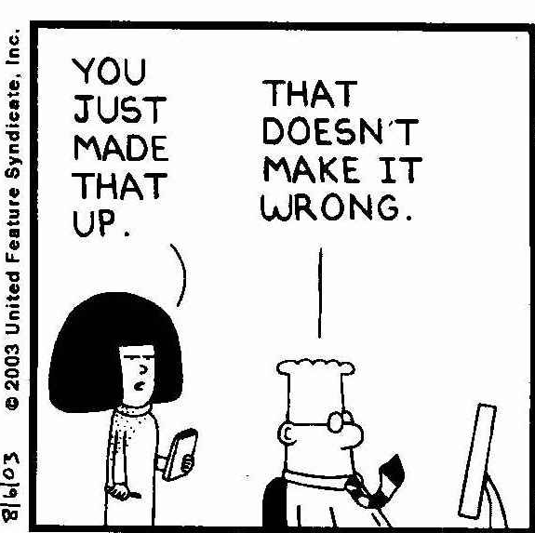
Uncertainty
How “certain” of the data are we?
How much “error” does it contain?
How well does the model match reality?
Goal:
  Understand and document uncertainties from data collection to publication
Notes:
This is uncertainty in the broadest sence

Slide 2
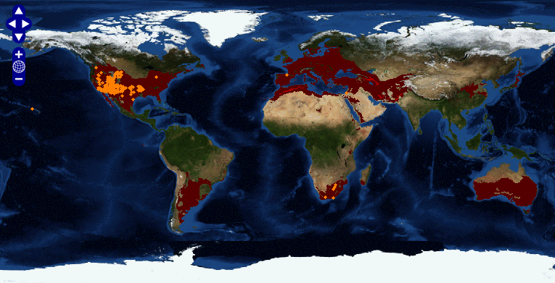
LifeMapper: Tamarix chinensis
LifeMapper.org

Slide 3
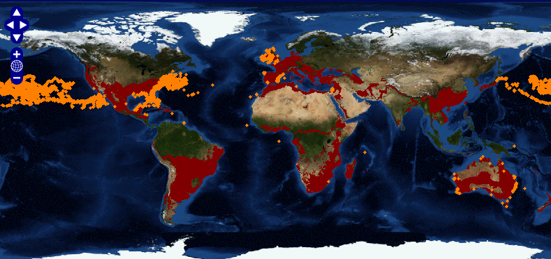
LifeMapper: Loggerhead Turtles
LifeMapper.org

Slide 4
Road Map of Uncertainty
Spatial Precision
Spatial Accuracy
Sample Bias
Identification Errors
Date problems
Gross Errors
Gridding
Sample Data
Predictor Layers
Noise
Correlation
Interpolation Error
Spatial Errors
Measurement Errors
Temporal Uncertainty
Over fitting?
Assumptions?
Modeling Software
Settings
How to determine?
Habitat Map
Response Curves
Model Performance Measures
Number of Parameters
AIC, AICc, BIC, AUC
Realistic?
Uncertainty maps?
Match expectations?
Over-fit?
Accurate measures?
What is the best model?
Notes:
Best model can vary based on the application and the available data
You can obtain an error layer if you Krige data to get an interpolated surface.

Slide 5
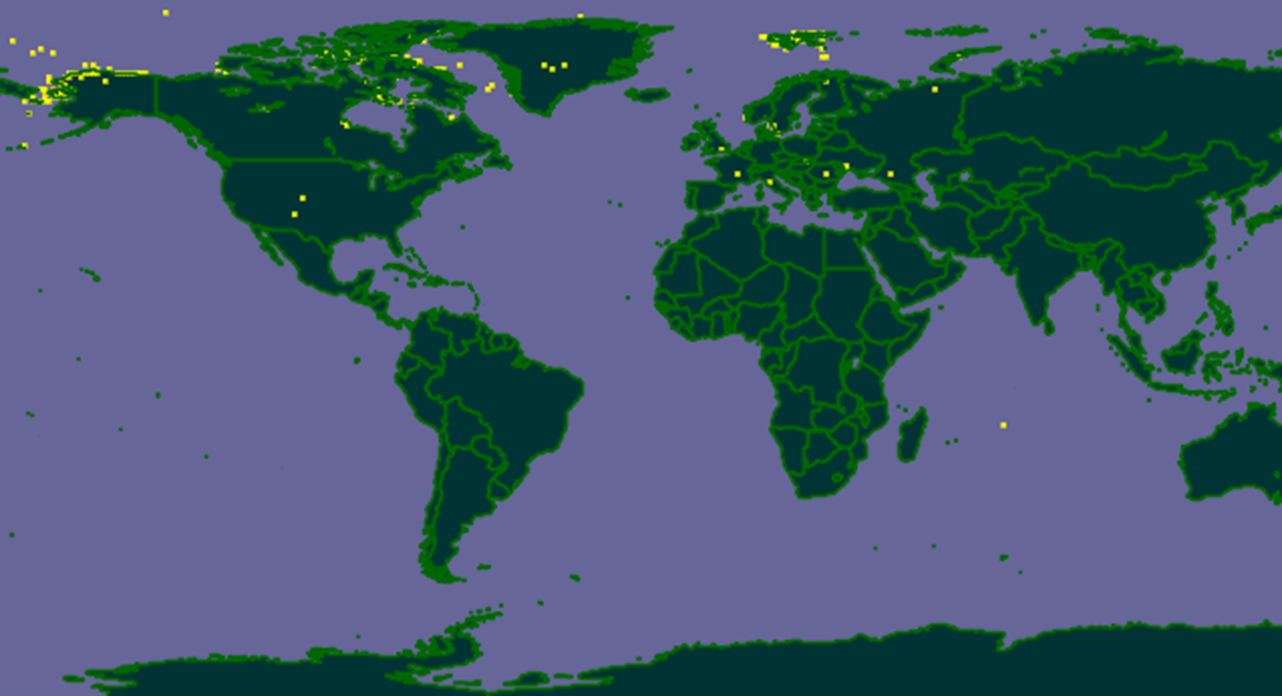
Occurrences of Polar Bears
From The Global Biodiversity Information Facility (www.gbif.org, 2011)

Slide 6
January 1st Dates
If you put just a “year”, like 2011, into a relational database, the database will return:
  Midnight, January 1st, of that year
In other words:
  2011 becomes:
  2011-01-01 00:00:00.00

Slide 7
Predictor Layers
Remotely sensed:
  DEMs, Visual, IR, NIR, SST, NPP, Sea Height
Integrated from multiple data sets:
  Bathymetry
Interpolated:
  Temp, precipitation, wind
  DO, Sub-surface temp, salinity, bottom type
Processed from other layers:
  Slope, aspect, distance to shore
From other models:
  Climate

Slide 8
BioClim/WorldClim Data

Slide 9
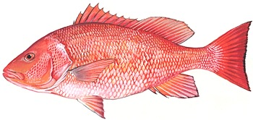
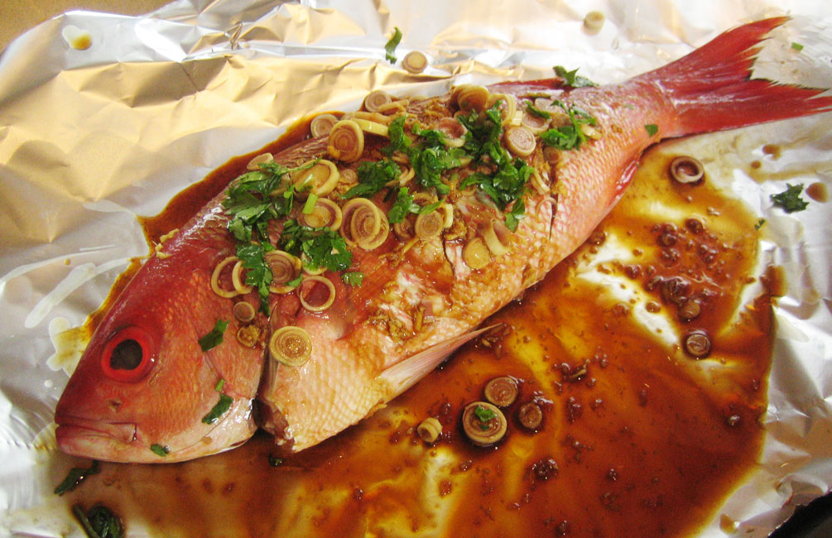

Red Snapper
An important recreational and commercial species
$7 - 70 million/year
www.safmc.net
lickyourownbowl.wordpress.com
outdooralabama.com

Slide 10
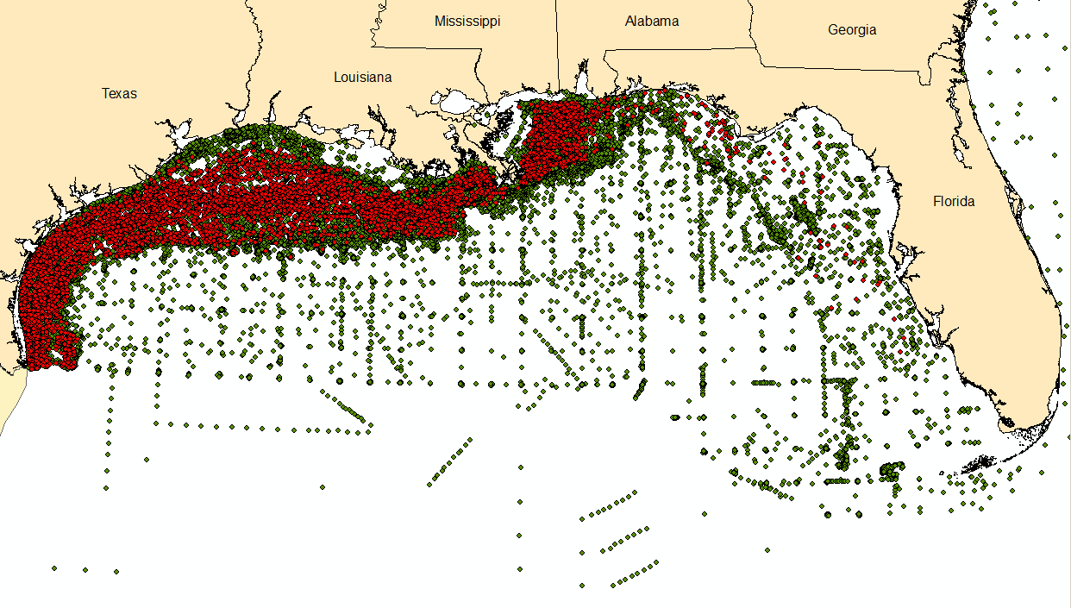
SEAMAP Trawls (>47,000 records)
Red Snapper Occurrences (>6,000 records)

Slide 11
Sample Data
Spatial Precision
  Standard Deviation of about 2 km
Spatial Accuracy:
  < 1km
Sampling Bias:
  Some areas more heavily sampled
Identification Errors:
  Unknown but red snapper are pretty easy to identify
Date problems:
  Not a temporal model
Gridding:
  Not at 9 kilometers
Notes:
2km estimated from looking a the length of the trawls

Slide 12
Jiggling The Samples
Randomly shifting the position of the points based on a given standard deviation based on sample uncertainty
Running the model repeatedly to see the potential effect of the uncertainty

Slide 13
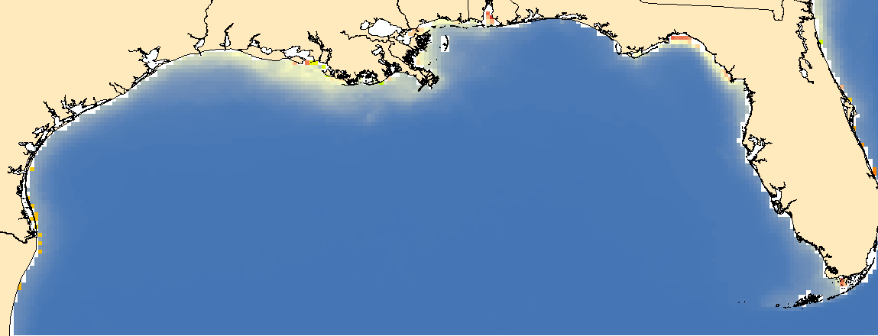
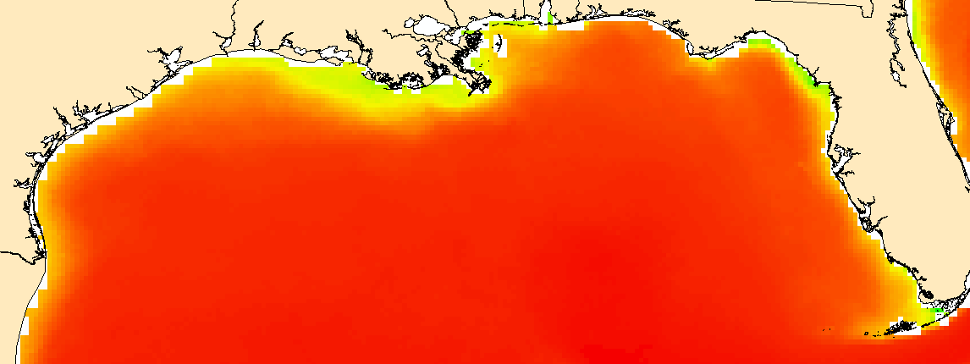
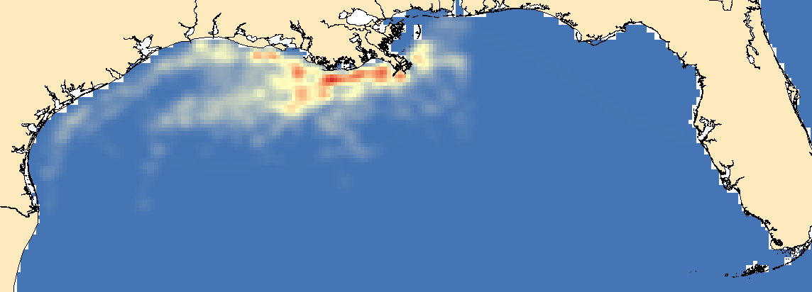
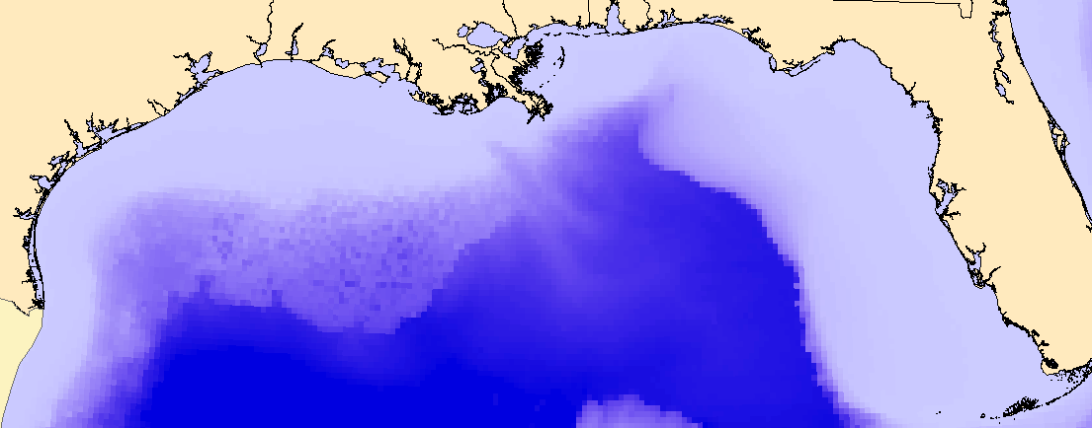
Sea Surface Temperature (SST)
NOAA
AVHRR Pathfinder Satellite
Spatial: 9km
Measured: <0.4 K
Net Primary Production (NPP)
Milligrams of Carbon per
Meter Squared per Day
OSU Ocean Productivity
Uncertainty?
Density of
Platforms and Pipelines
Created from Bureau of Ocean Energy Management (BOEM) Point Data Set
Uncertainty?
Bathymetry
Resampled from 90m
NOAA Coastal Inundation Dataset
And others
Uncertainty < 9km

Slide 14
Predictor Resolution
Should model at the lowest resolution of the predictor layers or lower
Lower resolution:
  Can reduce problems from sample data uncertainty
  In same cases can combine sample data into measures such as CPUE, density, abundance
  Reduces detail of final model
For these tests: 9km

Slide 15
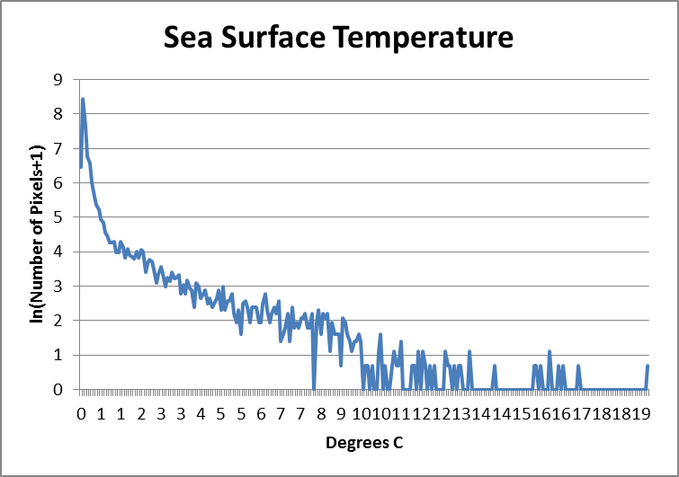
Histograms of Predictor Layers
Notes:
Minimal noise in the predictors
This is also an advantage of modeling at relative low resolution

Slide 16
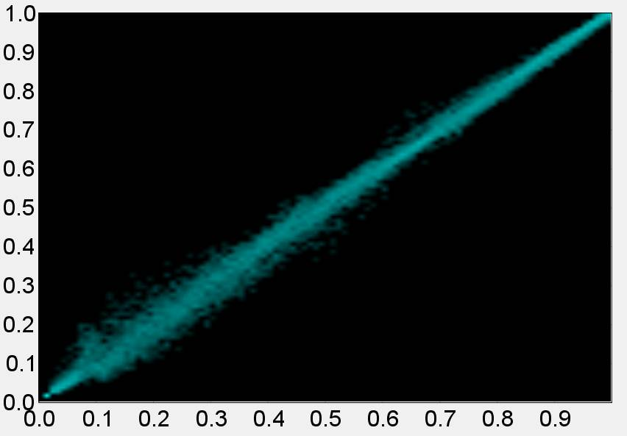
Predictor Layer Uncertainty
Noise: Minimal
Correlation: Eliminate NPP
Spatial Errors: Unknown, < 9km?
Measurement errors: Minimal to Unknown
Spearman’s Coefficient
NPP to SST
Correlation: 0.99

Slide 17
Modeling Software: Maxent
Popular, relatively easy to use
Only requires presence points
Known for over-fitting
Performs “piece-wise” regression
Assumes:
  Predictors are error free
  Independence of errors in response
  Lack of correlation in predictors
  Constant variance
  Random data collection over sample area

Slide 18
Experiments
Different regularization multipliers
  Select regularization for other tests
Try different numbers of samples
  Determine the number of samples to use
“Jiggle” the sample data spatially
  Introduce different amounts of spatial error

Slide 19
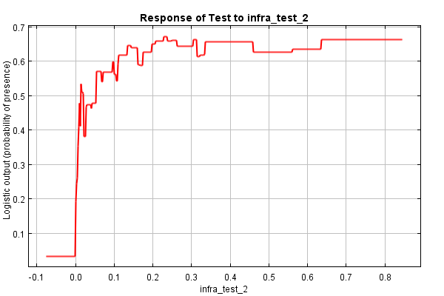
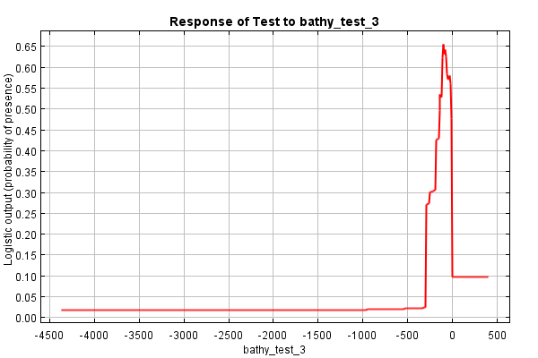
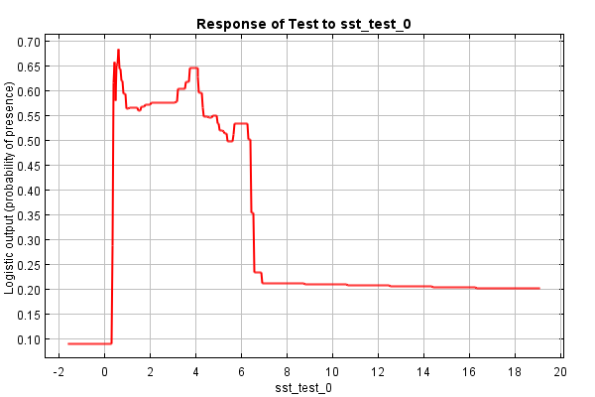
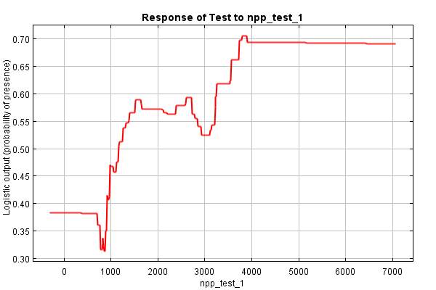
Regularization=0.1
Notes:
An example of over fitting

Slide 20
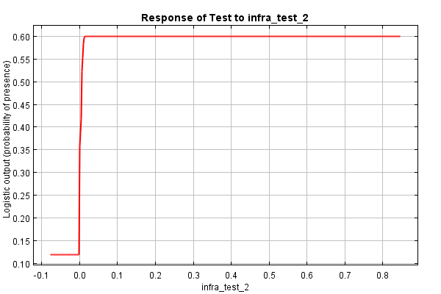
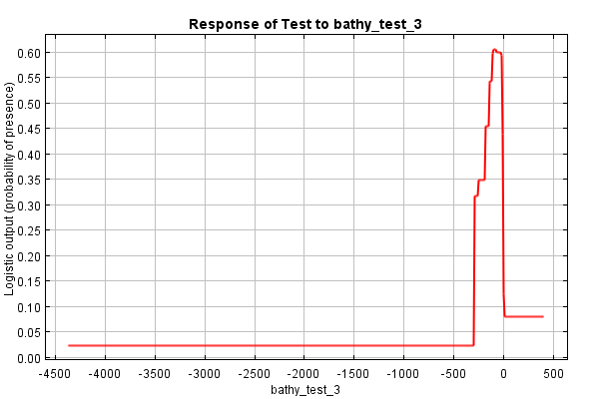
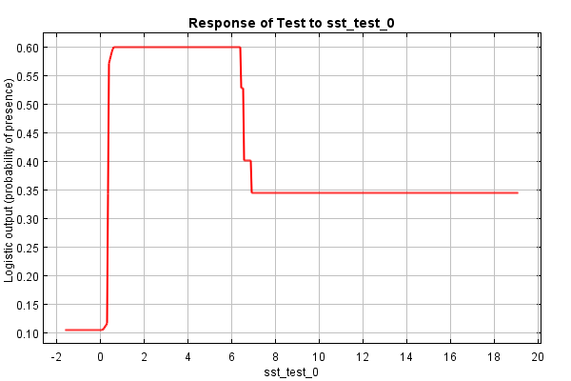
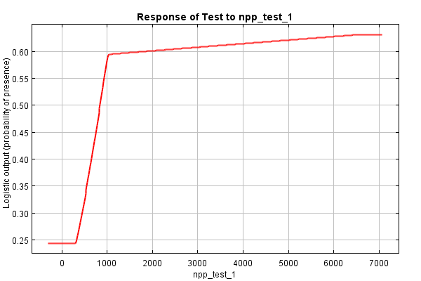
Regularization=1.2

Slide 21
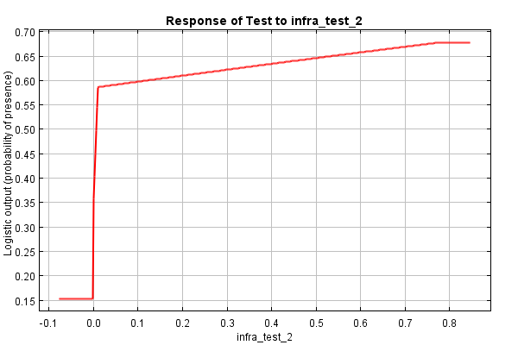
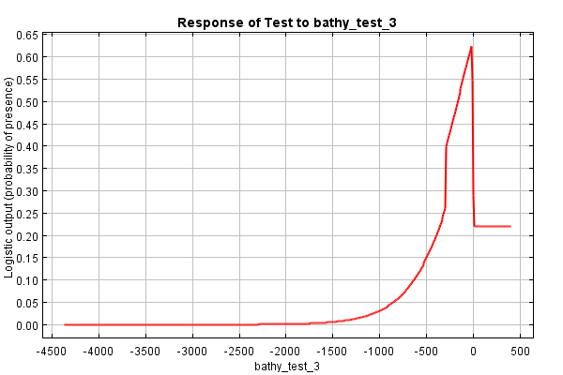
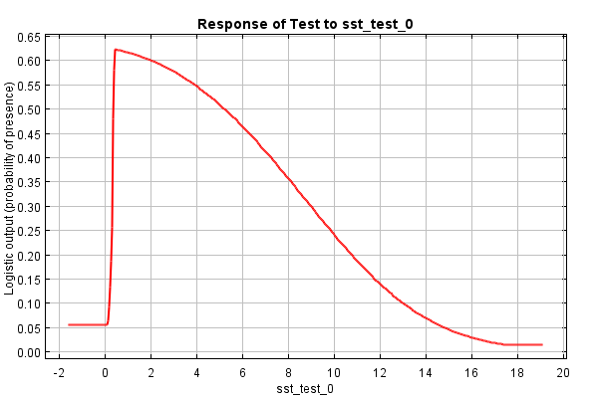
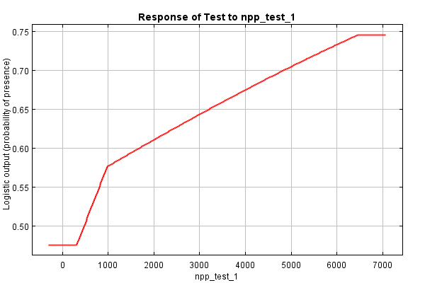
Regularization=10

Slide 22
Regularization=0.1
Regularization=1.2
Regularization=10
Notes:
AUC gives the highest value with the lowest regularization (and the most over-fitting)
AIC gives the lowest (best) value when

Slide 23
Percent | Number of Samples | Number of Parameters | AIC | AUC
10% | 665 | 136 | 7549 | 0.947
20% | 1330 | 166 | 13,258 | 0.941
30% | 1995 | 120 | 16,850 | 0.936
50% | 3326 | 159 | 23,839 | 0.929
70% | 4656 | 162 | 28,293 | 0.924
100% | 6651 | 81 | 72,901 | 0.918
Notes:
Demonstrates why we can’t use AIC with different sets of sample data
AUC Goes up with smaller numbers of points because the amount of variance in the sample data is smaller
Could lead to thinking that we have enough data points but we’ve really under sampled the species niche

Slide 24
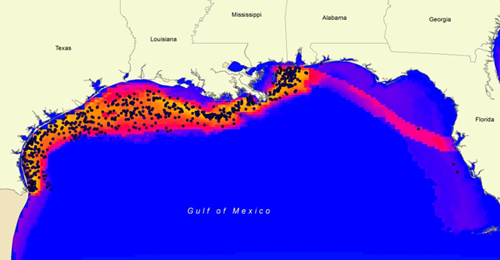
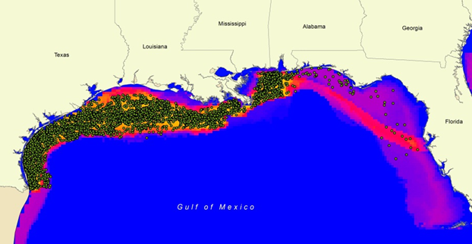
10%
Sample
Points
Optimal
Habitat
Poor
Habitat
100%
Sample
Points

Slide 25
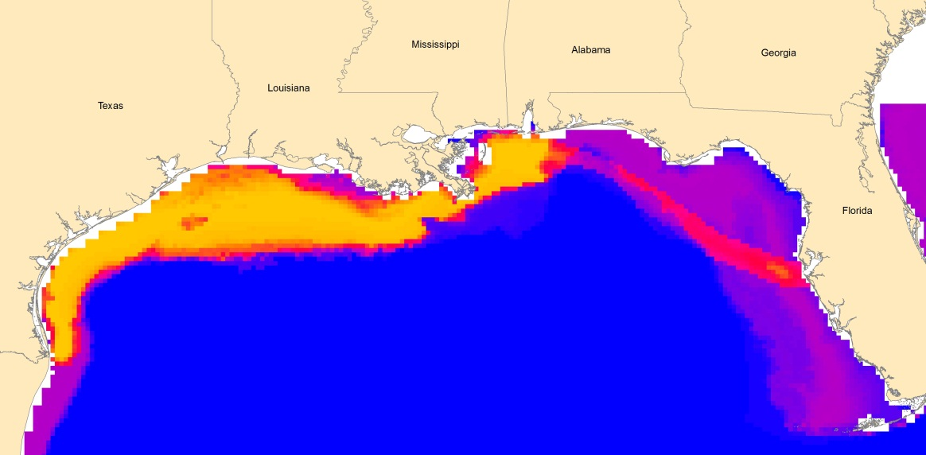
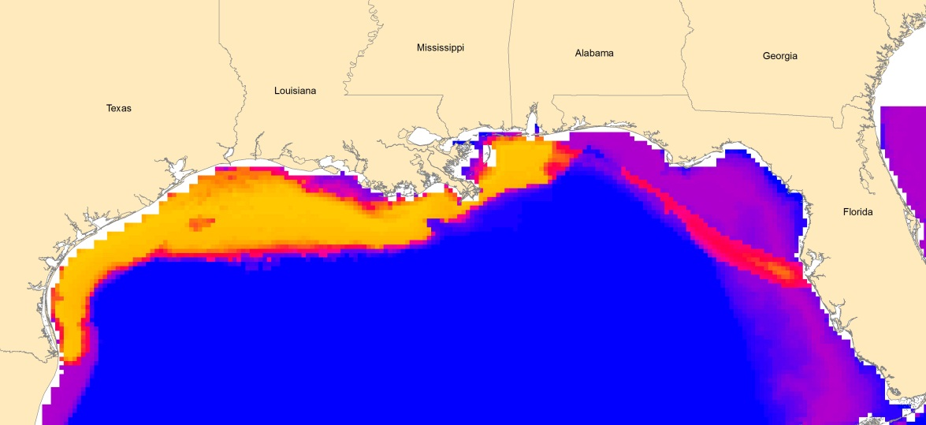
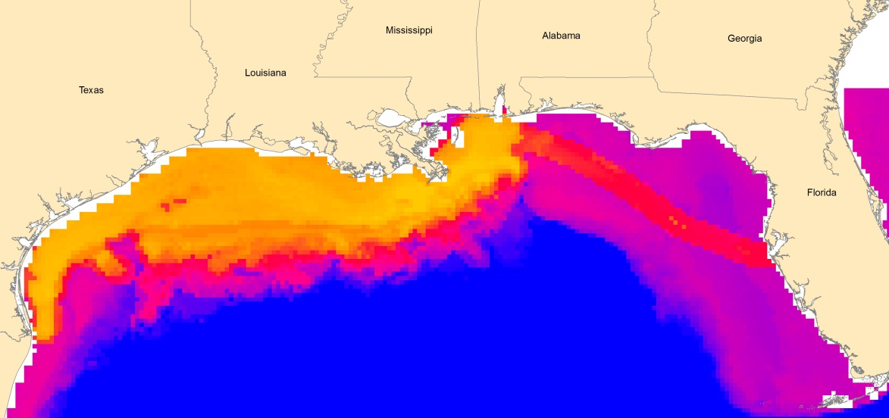
Jiggling
No Jiggling
Std Dev=4.4km
Std Dev=55km

Slide 26
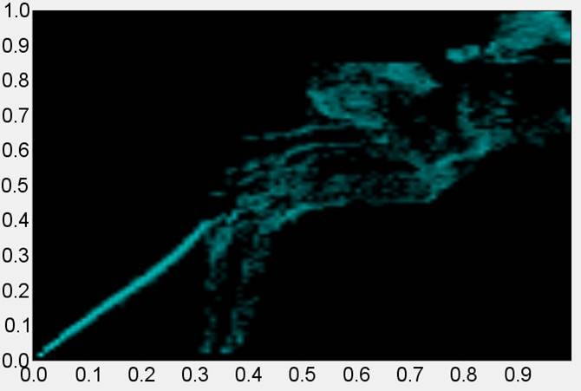
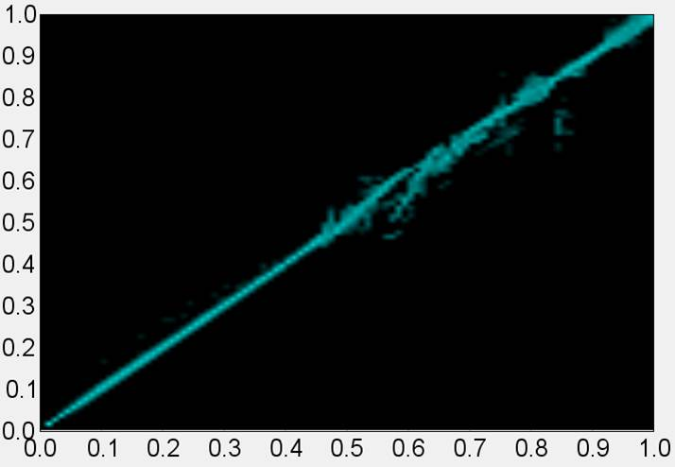
Jiggling
Spearman’s Correlation
0 vs. 4.4km, Correlation = .997
0 vs. 55km, Correlation = .919

Slide 27
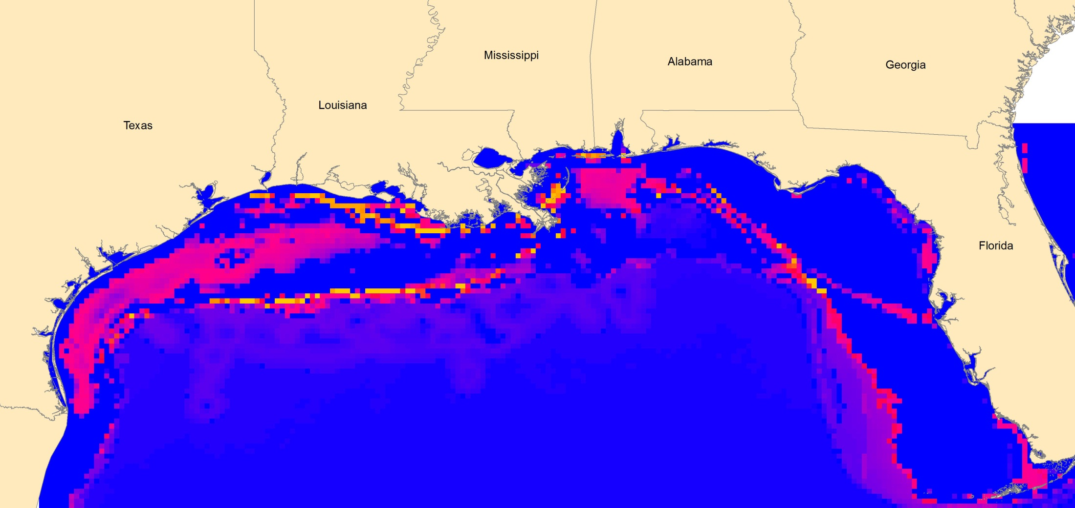
Uncertainty Maps
Standard Deviation of Jiggling Points by 4.4km
0.0008
0.32

Slide 28

Conclusions
We can improve HSMs over the default settings in Maxent
We can determine uncertainty in some cases
Next Steps
  Support uncertainty for each data point
  Improve uncertainty analysis and visualization for predictor layers
  Begin adding uncertainty analysis and maps to products

Slide 29
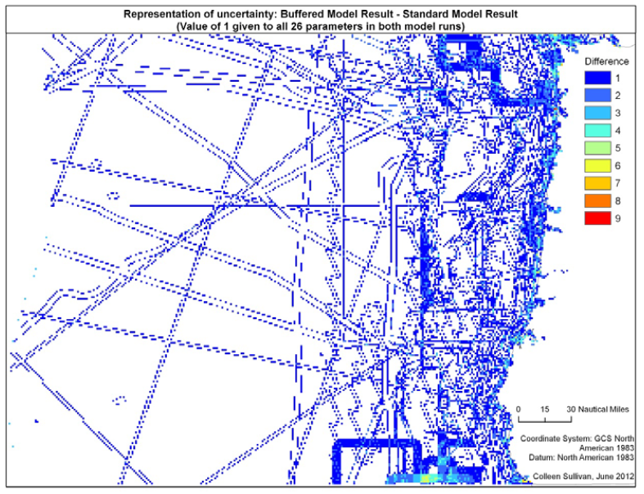
Communicating Uncertainy
Colleen Sullivan, 2012

Slide 30
References
Anderson, Model Based Inference in the Life Sciences: A Primer on Evidence
AVHRR Technical Specifications: http://data.nodc.noaa.gov/pathfinder/Version5.2/GDS_TechSpecs_v2.0.pdf
Chil’s JP, Delfiner P , Geostatistics: Modeling Spatial Uncertainty
Franklin J, Mapping Species Distributions: Spatial Inference and Prediction. Cambridge University Press, Cambridge
Hunsaker CT et. al., Spatial Uncertainty in Ecology: Implications for Remote Sensing and GIS Applications
Maxent: http://www.cs.princeton.edu/~schapire/maxent/
Phillips SJ, Anderson RP, Schapire RE (2006) Maximum entropy modeling of species geographic distributions. Ecol Model 190 (3-4):231-259.
Warren DL, Seifert SN (2011) Ecological niche modeling in Maxent: the importance of model complexity and the performance of model selection criteria. Ecological Applications 21 (2):335-342.
Wenzhong S, Principles of Modeling Uncertainties in Spatial Data and Spatial Analyses

Slide 31
Other Issues…
Selecting background (absence points)
Clamping:
  Prevents prediction outside the predictors used to create the model
Thresholds

Slide 32
Additional Slides

Slide 33
Communicating Uncertainy
Colleen Sullivan, 2012

Slide 34
Staircase of Knowledge
Wisdom
Judgment
Understanding
Comprehension
Integration
Knowledge
Organization
Interpretation
Information
Human value added
Selection
Testing
Data
Observation
And
Measurement
Verification
Increasing Subjectivity
Environmental Monitoring and Characterization, Aritola, Pepper, and Brusseau

